Slide 1

AI-Based Gear Defect Detection Using CNN
Gears are critical in mechanical systems, but defects can lead to machine failure, production losses, and safety hazards. Manual inspection is time-consuming and error-prone. This presentation outlines the development of an AI-based defect detection system using CNN to classify gear images into different fault types, automating defect detection and improving quality control.

Slide 2
Problem Statement & Objective
Problem
Objective
Gears are critical components; defects can lead to machine failure, production losses, and safety hazards. Manual inspection is time-consuming and error-prone.
Develop an AI-based defect detection system using CNN to classify gear images into different fault types, automating defect detection and improving quality control.

Slide 3

Dataset Description
Image Count
Fault Types
The dataset consists of 936 gear images.
Images are classified into 9 fault types, including healthy gears, missing tooth, crack, spalling, and varying degrees of chipping.
Class Distribution
Each class contains 104 images, ensuring a balanced dataset.

Slide 4

Data Preprocessing & Augmentation
1
Resizing
2
Normalization
Images were resized to (128x128) for uniformity.
Pixel values were scaled between 0-1.
3
Augmentation
Rotation, flipping, and zoom were applied to increase dataset diversity and improve model generalization.

Slide 5
Model Architecture (CNN)
Convolutional Layers
1
Extract features from gear images.
2
Batch Normalization
Speeds up training & stabilizes learning.
Max Pooling
3
Reduces spatial dimensions while preserving features.
4
Dropout
Prevents overfitting.
Dense Layers
5
Fully connected layers for classification.
6
Softmax Activation
Outputs probability distribution over 9 classes.

Slide 6
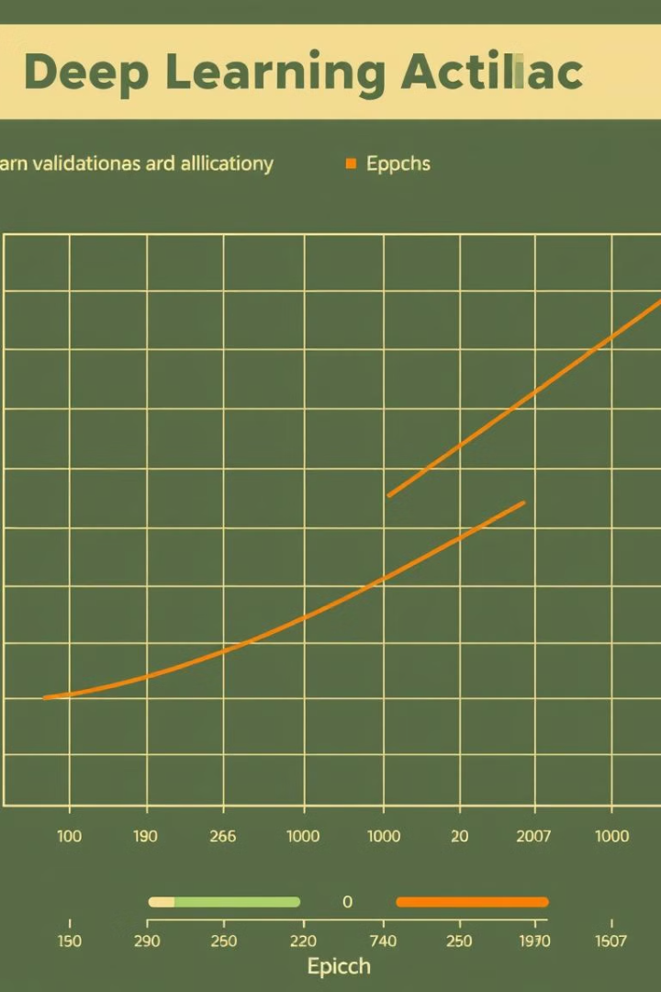



Model Compilation & Training
Optimizer
Adam (adaptive learning rate for faster convergence).
Loss Function
Categorical Crossentropy (for multi-class classification).
Metric
Accuracy.
The model was compiled using the Adam optimizer, categorical crossentropy loss function, and accuracy metric. It was trained for 20 epochs with validation data.

Slide 7
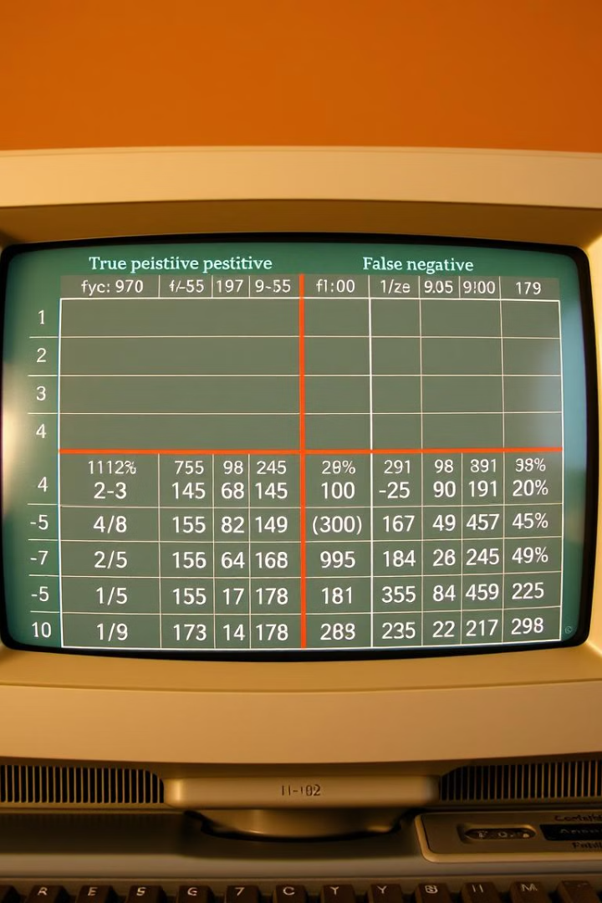
Results & Evaluation
100
Training Accuracy
Achieved 100% accuracy on the training dataset.
100
Validation Accuracy
Achieved 100% accuracy on the validation dataset.
The model achieved perfect accuracy on both training and validation datasets, indicating successful learning and generalization. A confusion matrix showcases model performance on different defect types.

Slide 8
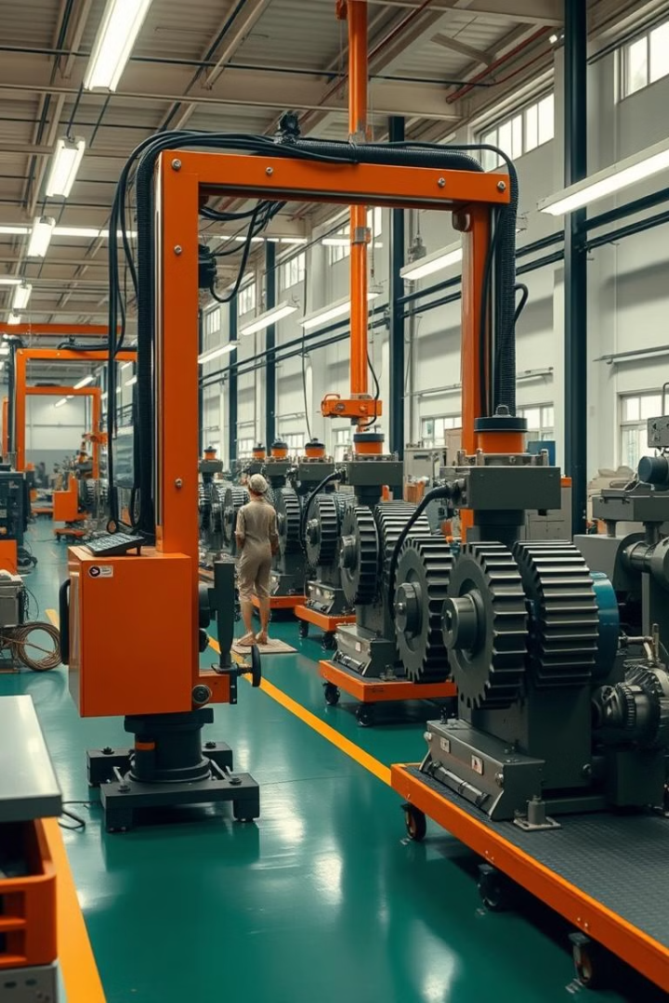




Business Impact & Conclusion
Automated Detection
Improved Quality
Enhanced Safety
Enhances quality control in manufacturing.
Prevents machine failures, enhancing safety & reliability.
Reduces manual inspection time.
Cost-Effective
Provides a cost-effective solution for large-scale industries.

Slide 9

Final Summary
The CNN-based defect detection model successfully classifies 9 gear defect types with high accuracy. It provides an automated, efficient, and cost-effective solution for defect detection in mechanical systems. This system improves quality control, prevents machine failures, and enhances safety and reliability in large-scale industries.

